Slide 1


VIVEKANAND EDUCATION SOCIETY INSTITUTE OF TECHNOLOGY (MUMBAI UNIVERSITY)
Department of Computer Engineering
Sr. Jr. Interaction Session
Presenters:
Shubhangi Zope D17B
Gauri Mahajan D17C
Khushboo Bajaj D17A
Minal Katware D17A
Gunjan Lalwani D17A

Slide 2
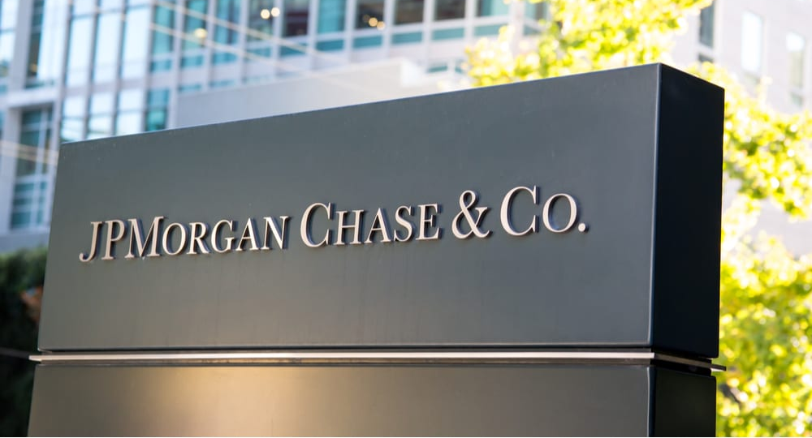
Naam toh suna hi hoga!

Slide 3
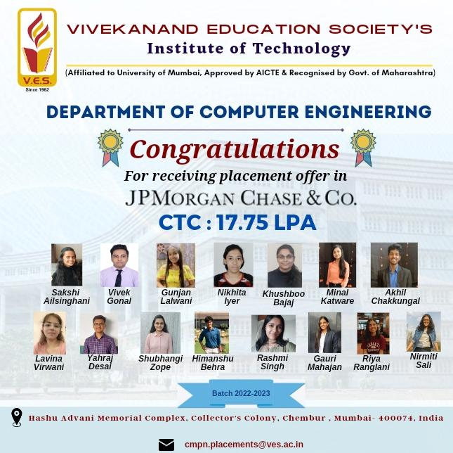

Slide 4
About JPMC:
JPMorgan Chase & Co. is an American multinational financial services company
Largest bank in the United States and the world's largest bank by market capitalization (as of 2023)
Leader in investment banking, financial services for consumers and small business, commercial banking, financial transactions processing and asset management.
$3.774 trillion worth of total assets
Fifth-largest banking institution in the world.
By revenue, it is the largest investment bank in the world

Slide 5
Company Details
Name of the Company: JPMC (JP Morgan Chase & Co)
Company status : Dream
Branches Eligible: BE ( CS, IT, EXTC, ETRX ) and MCA
Eligibility Criteria: no live ATKT
Education Gap: Not more than 1 year
CGPA >=7(aggregate)
Salary: CTC: 17.75 LPA
Position : Full Time Software Engineer
Date of Drive: 9th March 2022

Slide 6
Placement Process
Roadshow Event
HireVue Test
Round 01
Round 03
Pre Placement drive
Coding Round
Round 02
Code For Good (Hackathon)

Slide 7

Coding Round

Slide 8
Coding Round
2 Coding Questions (50 marks each)
Held on Hackerrank platform.
Time Slot:18th March to 23rd March (Give test on first day itself don’t delay)
No negative marking.
75 mins are allotted to you.
Questions:
Break A Palindrome
Uncommon words from Two Sentences
Very less probability of same questions (Be prepared)
Level from easy to medium
Mostly based on DSA.
Start practicing on platforms like Leetcode, Codechef, Hackerrank.

Slide 9
Some more questions with solution
Identical distribution
Maximum units on a truck- solution
Reduce the array
Reverse complement of a DNA

Slide 10

Video Interview

Slide 11
Video Interview
Round 2(HireVue Round ):
Time Slot: 28 March 2022 to 1st April 2022
2 Hr questions were displayed on the screen.
No of Attempts given:2
Same questions for all
Questions :
Provide an example of a recent experience that you would describe as a real learning experience. Please describe the situation and outcome.
What specific goals have you established for your career?
Start practicing in front of a mirror Or record yourself until you become confident enough. Take suggestions from friends, parents, and colleagues.

Slide 12
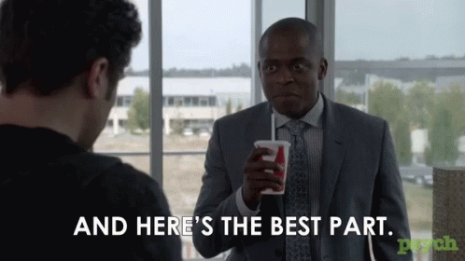
Code for good

Slide 13
Code For Good
Round 3(Code for Good Hackathon (Final Round)):
Time Slot: 9th June 2022 to 12th June 2022
Hackathon Conducted: 11th June 2022 to 12th June 2022
10th June : mentor meeting(Prepare yourself with good introduction covering all the points about you)
Try to decide techstack prior to Hackathon day with team.
Complete the basic necessities of project first and then go to other features
Make sure you are in mentor’s good books.
Interact with each other.(Here Interaction with mentors and team members plays a very important role)
2 One-One Interview was held with mentors.

Slide 14
Experience of Khushboo Bajaj
Round 3(Code for Good Hackathon (Final Round)):
Questions asked in One-One Interaction(1st Round):
What do you do in your free time ?
Why JPMC?
What would you prefer JPMC or Microsoft?
What are other companies you want to be placed in other than JPMC?
How’s everyone in the team? (Never give negative feedback about team members)
From my resume, he asked me about my Third Year project where we used payment integration.
Are you available in Mumbai, Bangalore, and Hyderabad? (Always say yes)
Are you going for further studies? (Always say No)

Slide 15
Experience of Khushboo Bajaj
Round 3(Code for Good Hackathon (Final Round)):
Questions asked in One-One Interaction(2nd Round):This was my technical round , but it is not necessary that everybody will be getting technical questions .. So be prepare for the worst.
Data Structure used in Google Map:Graph
Algorithms used in Google Map
What were your favourite subjects in Sem6?
What is data mining?
What is difference between SQL and NOSQL?
What is the advantage of Normalisation?
What do you meant by ACID?

Slide 16
Round 3(Code for Good Hackathon (Final Round)):
Questions asked in One-One Interaction(2nd Round):This was my technical round , but it is not necessary that everybody will be getting technical questions .. So be prepare for the worst.
What is your favourite data structure?
I answered HashMap, so he asked me why? Because of O(1) searching.
In Real Life where we use HashMap?
Which searching algorithm is used in Tree Data Structure?
DFS(We use Stack)
BFS(We use Queue)
Time Complexity

Slide 17
Round 3(Final Round) Contd:
Questions asked in One-One Interaction(2nd Round):This was my technical round , but it is not necessary that everybody will be getting technical questions .. So be prepare for the worst.
How do you optimise recursion?(Dynamic Programming)
How dp works?
If you want to find the factorial how dp works there?
He asked me about any questions. I asked him about the responsibilities.
Never comeback without asking questions
Try to take initiative and participate like giving presentation or explaining the project.
48 students were selected for code for good, out of which 41 students were placed.

Slide 18
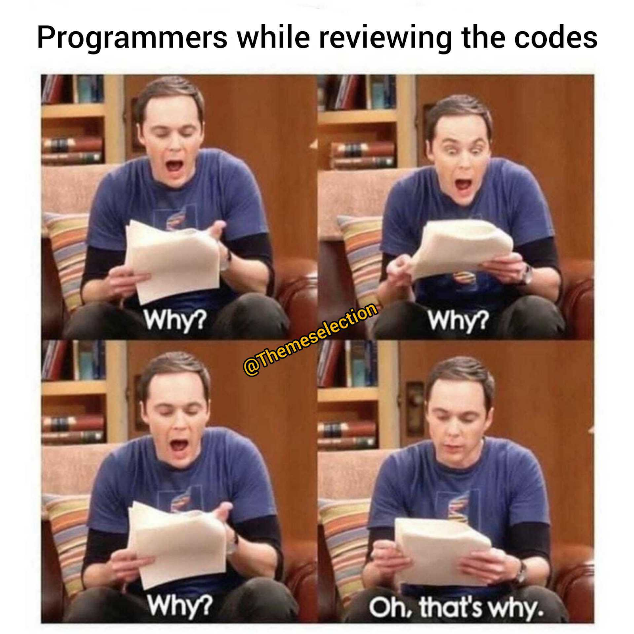
Code for Good Experience Gauri Mahajan
Some fun stuff to remember
Team meet before CFG
At the start of the hackathon they gave us a team activity. We were told to submit a coding meme. Also decide a name for our team.
The communication with your mentor and team is through their application called as “Slack”.
Once you get selected you receive multiple mails.

Slide 19

Code for Good Experience
You are provided a link of their platform over which all the submissions and problem statements get updated.(www.c4g.bemyapp.com)
Mentor Interaction- This was in the middle of day 01
Night time is the most crucial one!
Don’t forget to commit.
Keep buffer time for checking your submissions.
Demo Video and Presentations
Goodiesssssss!!!!

Slide 20
Code for Good Experience
Shubhangi Zope
Try to Introduce yourself in a unique manner
Try to take the initiative, discuss as much as possible with your team, talk confidently, support & listen to your teammate’s points
Try to be quick & fill up the form as soon as they are releasing it.
Decide the tech stack before the hackathon after discussing with your teammates and distribute the roles accordingly
Presentation is as important as developing the solution
Just be confident & yourself while talking

Slide 21
Some Additional Points
Make sure you have well written and organised strategically resume(mention your branch in your resume)
Good projects in your resume
You should have good hands on techstacks
Good Hands in Problem Solving and Data Structures
You must know atleast one frontend techstack and backend techstack
Be confident in your introduce yourself(should be precise and impressive)
Give your 100% in each round.

Slide 22
Resources
Leetcode
GeeksForGeeks
Khushboo Bajaj Experience Letter(This will give you more detail )
Job Description

Slide 23
Contact
You can contact us on following email id for any queries or doubts.
Khushboo Bajaj -2019khushboo.bajaj@ves.ac.in
Gauri Mahajan - 2019gauri.mahajan@ves.ac.in
Shubhangi Zope -2019shubhangi.zope@ves.ac.in
Gunjan Lalwani -2019gunjan.lalwani@ves.ac.in
Minal Katware -2019minal.katware@ves.ac.in

Slide 24
Any Questions?

Slide 25

Thank You & All the besttt!!!

